Slide 1
The compilation of telecommunications, computer and information services
Natalie Jefferies
Grace Atkinson
ONS

Slide 2
Sourcing and processing data

Slide 3
International Trade in Services (ITIS) survey
The ITIS survey is the UK’s biggest trade in services dataset and contributes roughly 50% of all trade in services data.
It is a quarterly and annual business survey that collects import and export data for 52.
Breakdowns are available by product, industry and geographical region.

Slide 4
Coverage of ITIS survey
The survey excludes travel, transport and banking sectors.
Businesses with 0-9 employees are currently excluded.
The quarterly survey samples 2,200 businesses.
The annual survey samples 16,500 businesses.
Companies from Northern Ireland are currently only included in the annual survey.

Slide 5
Sampling for ITIS survey
High propensity industries are targeted using random sampling during the annual sampling phase.
Low propensity industries are identified using their responses about importing/exporting on the ONS Annual Business Survey (ABS).
A panel of known, large respondents is identified, maintained and sampled each year/quarter.

Slide 6
Outliering and estimation in ITIS
A winsorisation method is used to outlier data, outliered data feeds into results but not estimation.
Quarterly data is weighted using a forecast ratio derived from the latest annual dataset.
In the annual data, known traders are not weighted. The random sample and businesses identified through the ABS are weighted using design weights to estimate for the non-sampled population.

Slide 7
Imputation in ITIS
Quarterly data uses means of ration imputation. Previous period values, either returned or imputed are multiplied by a single mean growth known as an imputation link.
Annual data is imputed dependent on how the company entered the sample
Means of ratio imputation is applied to known traders
Ratio of means is applied to the companies from the ABS
Median imputation is applied to the random sample and ABS companies with no previous data.

Slide 8
Finalising the data

Slide 9
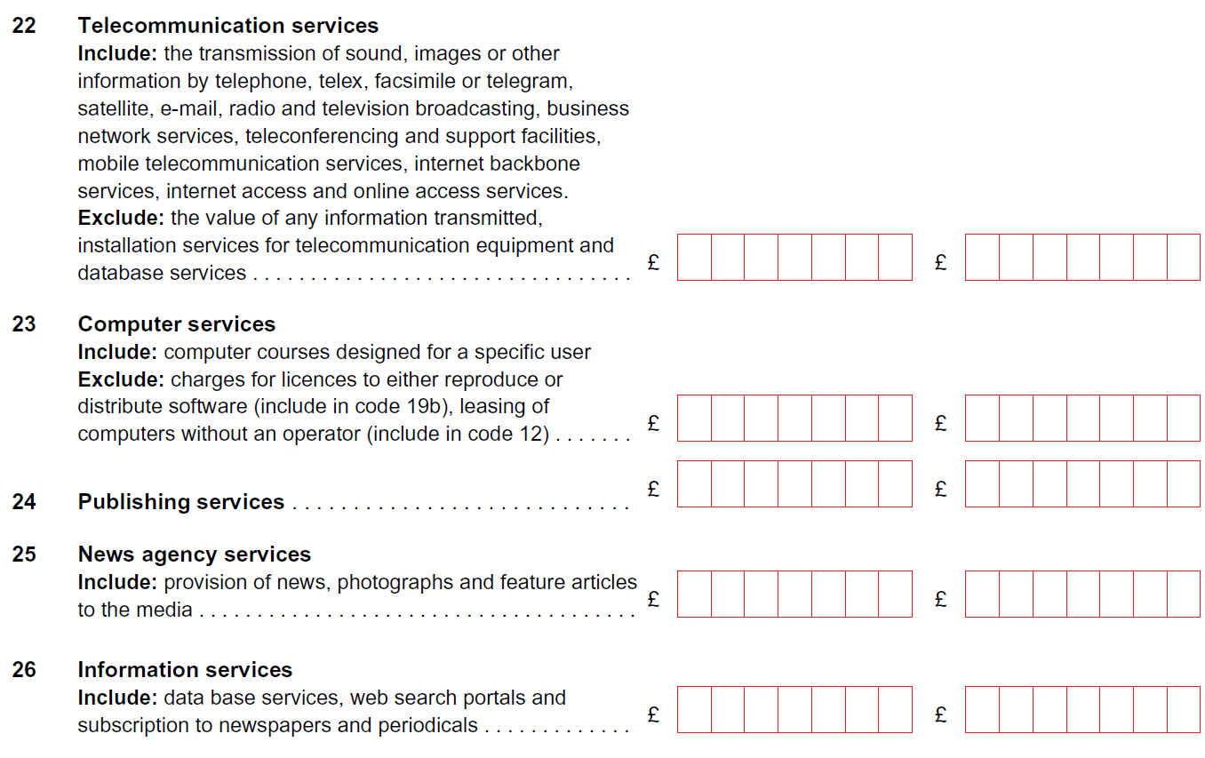
ITIS products
These are the five products collected by ITIS that make up the telecommunications, computer and information services account.

Slide 10
Final processing
Data from the relevant ITIS products are collated, and converted into EBOPS.
Data will then go through supply-use balancing to give us final figures for the account.
Additional processing for specific releases can then be completed, geography information also collected from ITIS is used to create country level data.

Slide 11
Data ONS publish

Slide 12
Published data
2 digit level
Quarterly and annual data
Non-seasonally adjusted
67 countries + 11 regional groups

Slide 13
Other ONS releases
Trade in Services by partner country
Trade in Services by Industry
Modes of Supply

Slide 14
Thank you for your time, we will now be happy to take any questions.
You can contact us using any of the below email addresses:
Trade@ons.gov.uk
Natalie.Jefferies@ons.gov.uk
Grace.Atkinson@ons.gov.uk

